Slide 1
Implementation of Marine Corps Spiritual Fitness Strategy within MARSOC CAPT Lee Axtell, CHC, USN Force Chaplain RP1 (FMF) Timothy Cambiado Senior Enlisted Advisor 30 April 2019 "Spiritus Invictus"
For Official Use Only (FOUO)
Unclassified

Slide 2
Spiritual Fitness ALMAR
R 031813Z Oct 16
ALMAR 033/16
MSGID/GENADMIN/CMC WASHINGTON DC DMCS//
SUBJ/SPIRITUAL FITNESS//
GENTEXT/REMARKS/1. Fitness is a vital part of being a United States Marine. Although we all understand the importance of being physically fit, it is also important to remember the other three aspects of overall fitness: spiritual, mental, and social. All of these aspects are essential to the well-being of each individual Marine and Sailor, and our Corps as a whole.
2. As Americas force in readiness, we must be prepared to answer our Nations call on a moments notice. A large part of that ability is our capacity for resilience. Regardless of the battle we just fought, we must be ready for our next success. Research indicates that spiritual fitness plays a key role in resiliency, in our ability to grow, develop, recover, heal, and adapt. Regardless of individual philosophy or beliefs, spiritual well-being makes us better warriors and people of character capable of making good choices on and off duty.
3. Beginning in October, the Marine Corps will be emphasizing all components of fitness, particularly the physical and spiritual aspects. During this time, I ask each of you to reflect on what you and the Marines and Sailors you lead are doing to achieve and maintain an optimal level of strength and resilience. Your leaders and chaplains at all levels stand ready to engage with you in this task. By attending to spiritual fitness with the same rigor given to physical, social and mental fitness, Marines and Sailors can become and remain the honorable warriors and model citizens our Nation expects.
4. Semper Fidelis, Robert B. Neller, General, U.S. Marine Corps, Commandant of the Marine Corps//
Unclassified

Slide 3
MPOTFF Holistic Model
Body
PFT/CFT
Critical Thinking
Mind
Sports
psychology
Combat
Athlete
Warrior transition (home location decompression)
Nutrition
Rapid
recovery
Stress screening
Strength/conditioning
Dependency
avoidance
Mental health
Human
Factors
Quality of life
Stress
coping
Family
readiness
Physical therapy
Positive experiences
Life meaning
Financial
security
Personal quest
Esprit de corps
Unit cohesion
Marriage enrichment
Pastoral care
Spirit
Unclassified

Slide 4
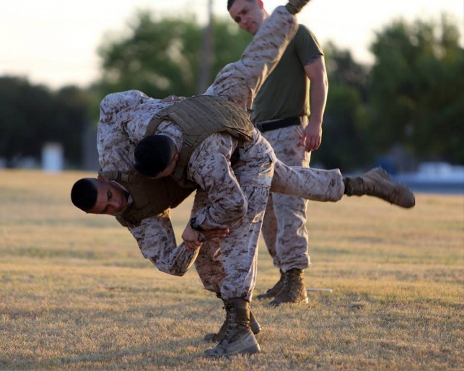
Roots of Spiritual Fitness
SPIRITUAL FITNESS begins with recognition of two dimensions to human existence…
OUR TANGIBLE SIDE
This is everything that can be experienced through our senses…
Heart
Environment
Mind
Body
OUR INTANGIBLE SIDE
This is everything in our life that cannot be seen or touched – our thoughts, beliefs, values, and worldview…
Unclassified

Slide 5
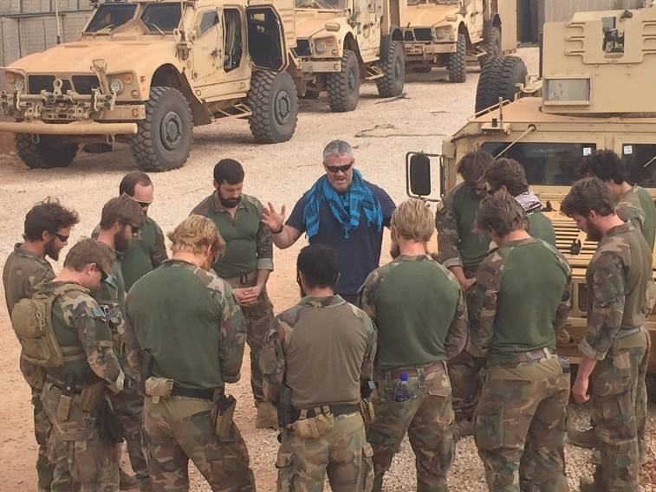
USMC Spiritual Fitness Strategy
Spiritual Fitness
The ability to adhere to beliefs, principles, and values needed to persevere and prevail in accomplishing missions.
Engagement Strategy
Provides Marine Corps leaders and their Chaplains a common language to communicate the building blocks of spiritual strength and resilience.
3 Goals of Strategy
Facilitate Communication
Top-down/bottom-up strategy to effectively communicate to every Marine what it means to be spiritually fit.
Provide Tools
Commanding Officers & Leaders – provide practical tools and resources to assist in developing spiritually fit Marines.
RSTs – provide communication strategies and tools to further equip them as SMEs to coach, counsel & help Marines be spiritually fit.
Improve Spiritual Fitness of Marines
BLUF: increase overall resilience of the Marine Corps.
Unclassified

Slide 6
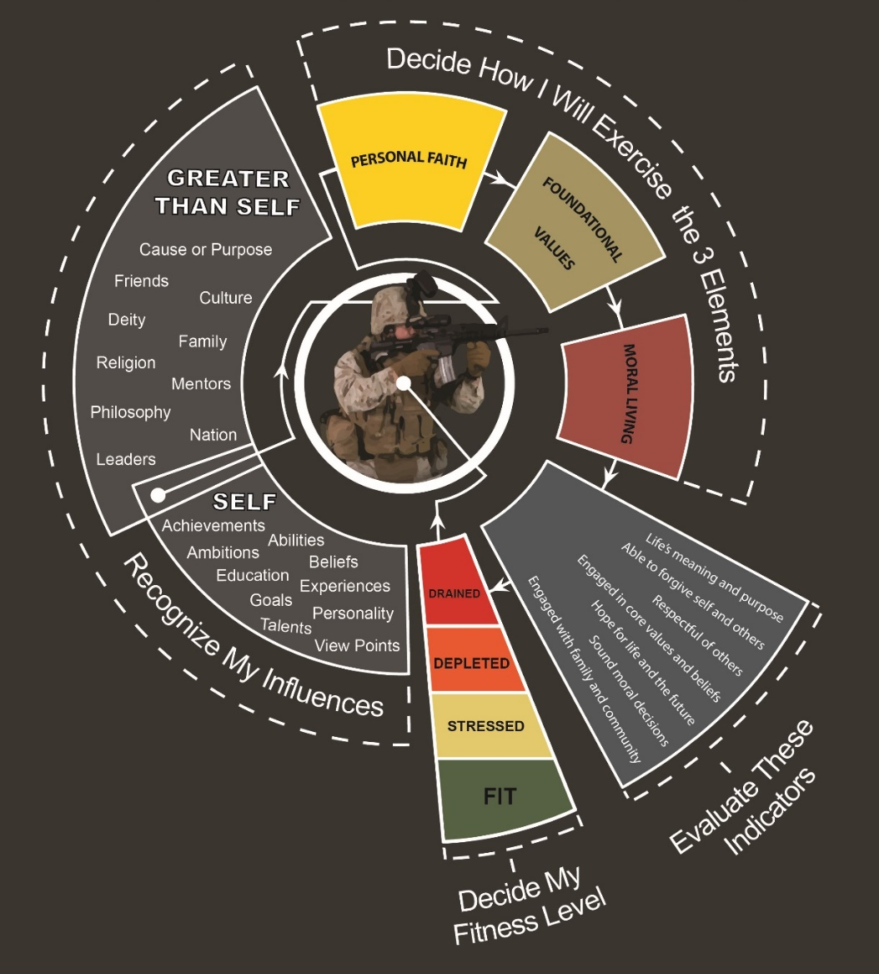
Spiritual Fitness Guide & Strategy
Based on the COSC model, a private self-assessment tool divided into 4 levels of fitness…
FIT | STRESSED | DEPLETED | DRAINED
Potential Indicators | Potential Indicators | Potential Indicators | Potential Indicators
Engaged in life’s meaning/purpose | Neglecting life’s meaning/purpose | Losing a sense of life’s meaning/purpose | Feels like life has no meaning/purpose
Hopeful about life/future | Less hopeful about life/future | Holds very little hope about life/future | Holds no hope about life/future
Makes sound moral decisions | Makes some poor moral decisions | Makes poor moral decisions routinely | Engaged in extreme immoral behavior
Fully engaged with family, friends, and community | Somewhat engaged with family, friends, and community | Weakly engaged with family, friends, and community | Not engaged with family, friends, or community
Able to forgive self and others | Difficulty forgiving self or others | Not likely to forgive self or others | Forgiveness is not an option
Respectful of others | Less respectful of others | Strong disrespect for others | Complete disrespect for others
Engaged in core values/beliefs | Straying from core values/beliefs | Disregards core beliefs/values | Abandoned core values/beliefs
Only meant to be used as private self-assessment tool – not designed to evaluate a Marine’s spiritual fitness.
Commands should not mandate the use of the SFG or require a Marine to disclose self-assessment results.
Training on this topic is encouraged – must be conducted by a chaplain or under a chaplain’s supervision.
Unclassified

Slide 7
Elements of Spiritual Fitness
Maintained by exercising three elements: Faith, Values, Morals
Personal Faith
All Marines have the ability to make a personal choice in which they will place their personal faith.
Faith may be characterized as belief or trust in self and/or a relationship with someone or something greater than one’s self.
Foundational Values
All Marines have the ability to make a personal choice regarding the values they will live by.
That, in turn, guide their choices, actions, and the character they display on and off duty.
Moral Living
All Marines make personal choices about the sources that guide moral living and the decision making process.
Marines must reflect upon and evaluate past decisions in order to inform their current and future decisions.
Unclassified

Slide 8
MARSOC Spiritual Fitness
Full Spectrum Spiritual Fitness – Faith – Values – Morals
Religious Services & Studies – Chaplain-led Bible studies, Tun Tavern Fellowship, “Raising a Modern Day Knight”, MARSOC support of worship services through Camp Lejeune.
Warrior Spirit Training (A&S) – focuses on Spiritual Fitness & personal growth to persevere, overcome and achieve.
Commander’s Devotions – regularly scheduled prayer/devotions with MARSOC Commanding Officers, as requested.
MCSOC Ethical Engagement – seeks for Raiders to further develop an ethical framework reinforced by leader-led case studies.
MRTC Tactical Ethics Program – developed in consultation with MRTC Chaplain, an instructor-led program being developed by the Citadel’s Krause Center.
Safety Stand-Downs – Chaplain focuses on how spirituality shapes moral/ethical decision making
Home Location Decompression (HLD) – an interdisciplinary post-deployment screening of all returning Raiders.
Dinner Workshops – Marriage enhancement dinner programs for couples.
Resilient Family Institute Retreats – SOF-specific weekend family retreats (MFP-2 & 11 funded).
Ministry of Presence
Unclassified

Slide 9
Recommendations
Take a positive approach to Spiritual Fitness focusing on strength, success and achievement – not just averting crisis.
Continue to assess our population – adapt programs to meet the needs of our unique context.
Further develop a full spectrum CRP that utilizing the Marine Corps Spiritual Fitness construct – faith, values, morals.
Continue to foster a culture of interdisciplinary cooperation and dialogue at every level – MPOTFF.
Develop Chaplain, Religious Program Specialist, and Leader led Spiritual Fitness training.
Integrate Spiritual Fitness at all levels to remind our Raiders at every opportunity the meaning of their mission.
Unclassified

Slide 10
QUESTIONS?
For Official Use Only (FOUO)
Unclassified

